Slide 1


WebGIS Lab 1
DEBAYAN MANDAL
Notes:
Introduction

Slide 2
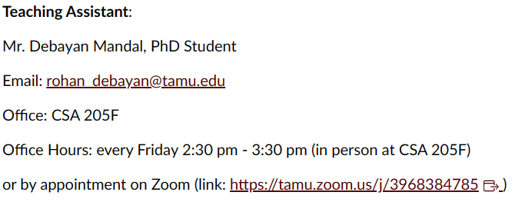
Lab Hours
Notes:
You can reach me through mail, office hours or even Canvas messaging.
Please mail me any troubles beforehand. Don’t wait till the submission date.

Slide 3
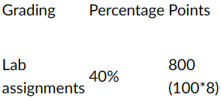
Any submissions after 10 days of due date will be marked out of 50 only
Grading And Late Policies
Notes:
Each lab has 100 points.
There are a total of 8 labs.
These contribute to the 40% of the total of 2000 points.
No submissions will be accepted after 5/4/2023

Slide 4
Quick recap of GitHub from Class
GitHub is a place to store and share code, manage projects, and build software.
Advantages of GitHub:
Collaboration/ Teamwork
Showcasing work and documentation
Version control and bug fixing
Integrates with most used platforms (Google Cloud, etc.)
To start using Texas A&M University's Enterprise GitHub, you first need a personal GitHub account. Reusing an existing account is okay if you already have one, or you can create a new one just for work
Notes:
Best for open-source code development.

Slide 5
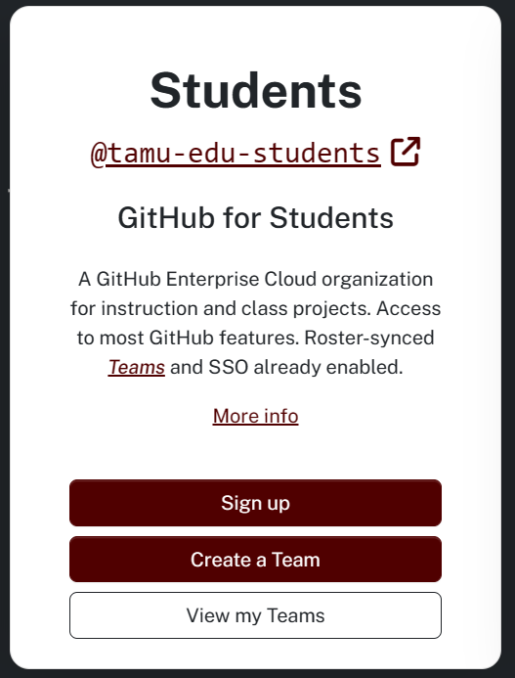
Create TAMU GitHub account
Go to github.tamu.edu
SignUp with NETID and password
Paid features for GitHub are available
1GB per repository and 100MB per file
Public repository – can be accessed by anyone
Internal repository – can be accessed by members of the Enterprise (anyone with a Texas A&M NetID).
Private repository – can be accessed by invited collaborators. (99999 per person limit)
Notes:
Paid features: individual private repositories, organizations, organization seats, etc.

Slide 6
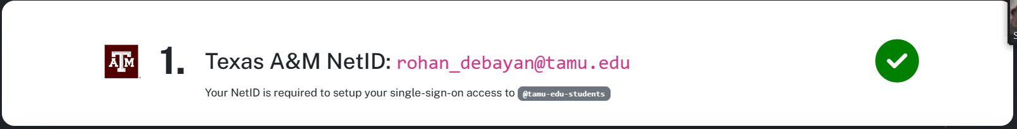
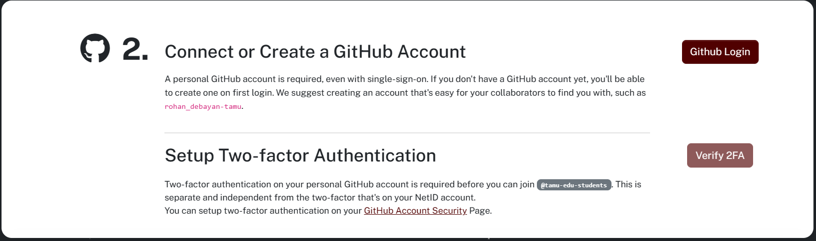
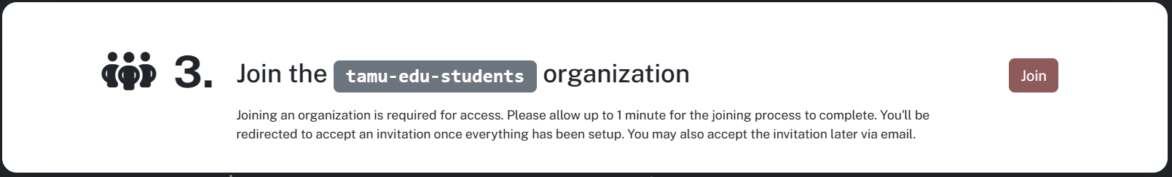
Notes:
Step 1 is done. Now we are going to work on Part 1 of second step.

Slide 7
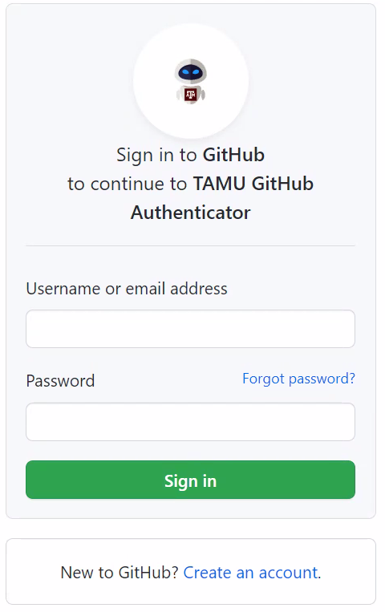
Fill in the Username and Password if you already have an existing GitHub Account
Continue to Slide 10 if sign in is successful
If you don’t have an existing account, click on Create an account

Slide 8
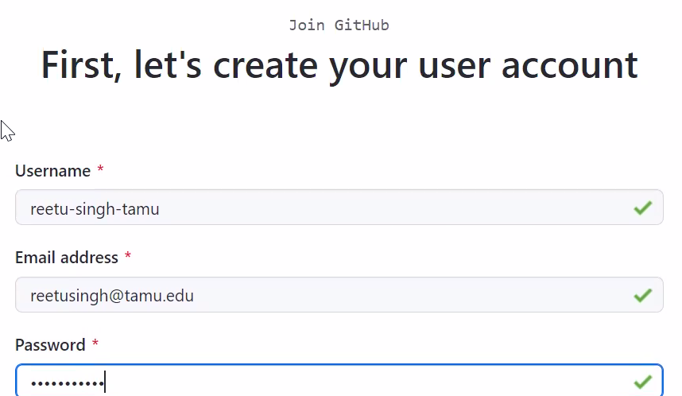
Creating an account
USERNAME
1
YOUR TAMU EMAIL ADDRESS
2
YOUR HOWDY PASSWORD
3

Slide 9
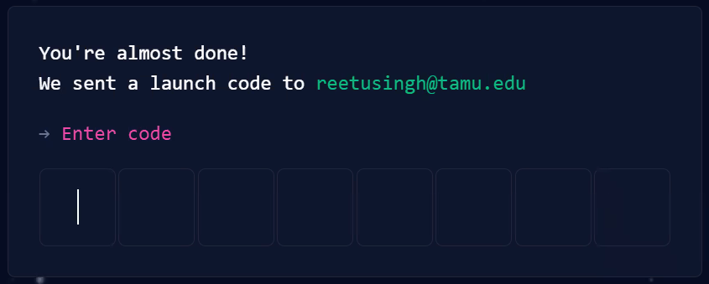
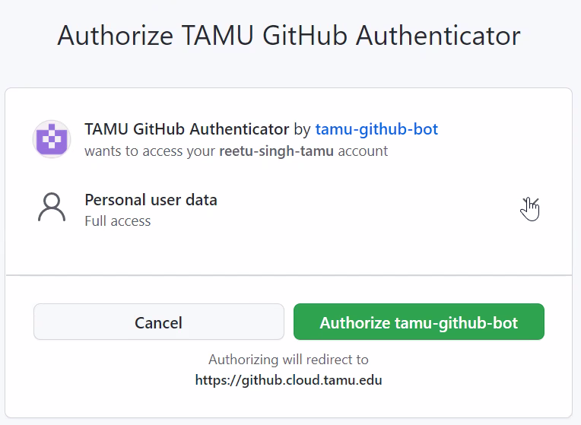
1
This code will be available in your tamu email
2

Slide 10
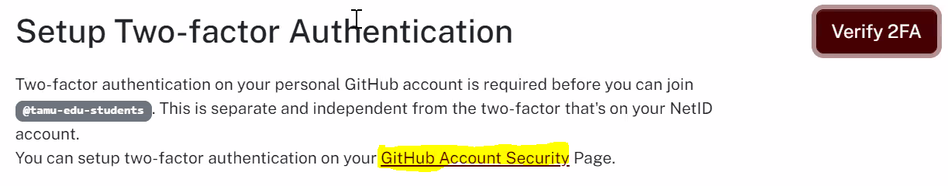
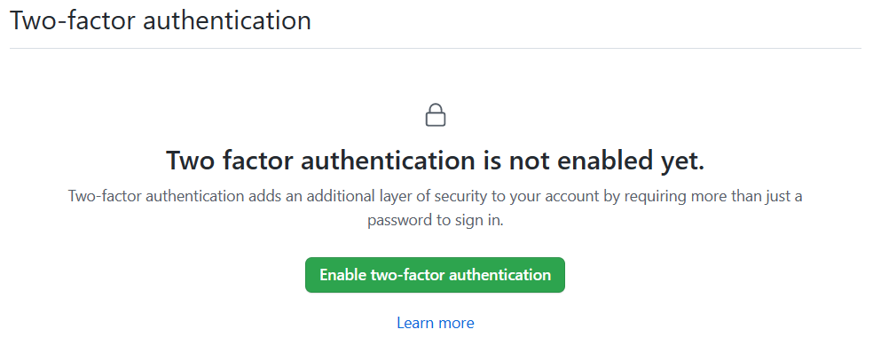
1
2
Notes:
Step 2 Part 1 is done. Now we are going to work on Part 2 of second step.
Click on GitHub Account Security Link. Don’t Click on Verify 2FA now.
Scroll down after this to see the Enable two-factor authentication button.

Slide 11
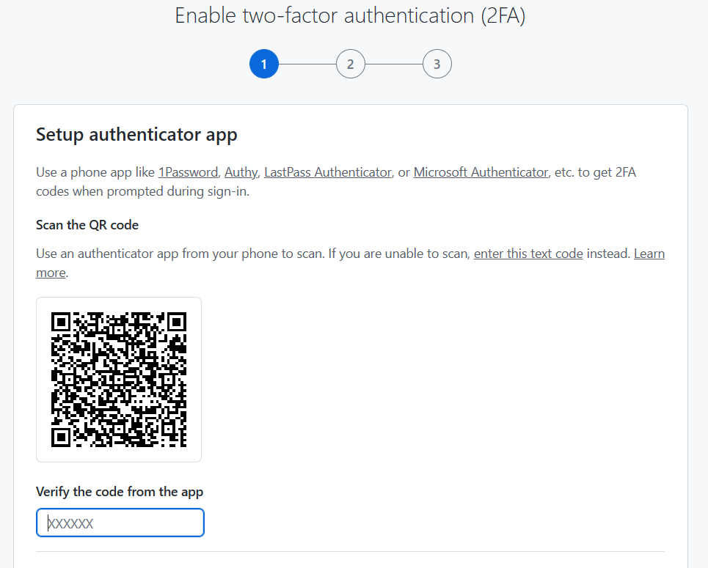
Download Microsoft Authenticator
Other options are:
1Password
Authy
LastPass Authenticator
Any other authenticator application
SEE NOTES FOR DETAILED INSTRUCTIONS
Notes:
1. Download Microsoft authenticator in your phone =>Select the option Scan QR Codes
2. Depending on your phone, it will either take fingerprint scan or passcode
3. Close the tab after you have entered the code and it shows successful

Slide 12
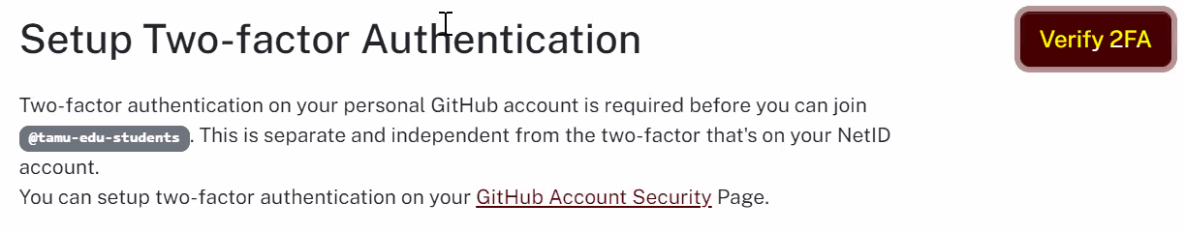
1
2
Notes:
After clicking Verify F2A the Step 2 is done. Now we are going to work on Step 3. Click on Join.

Slide 13
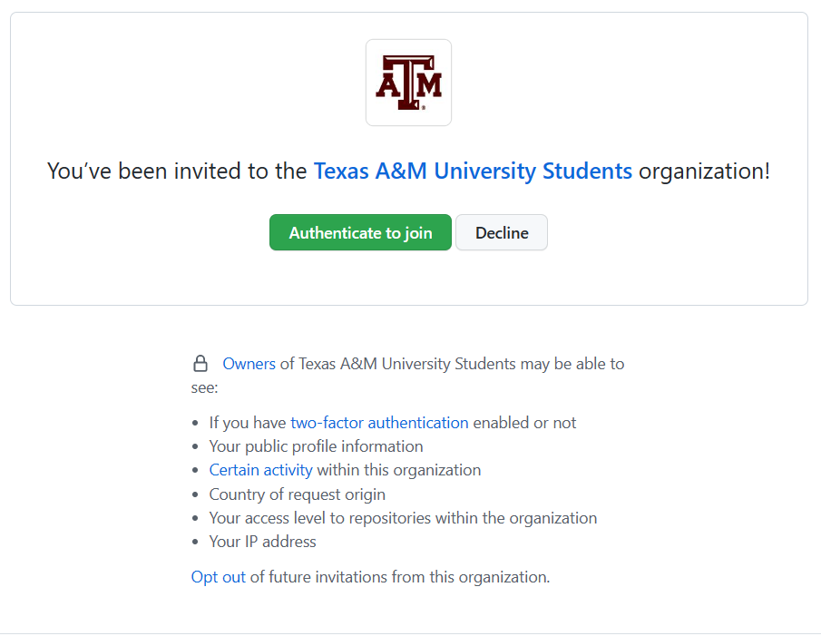
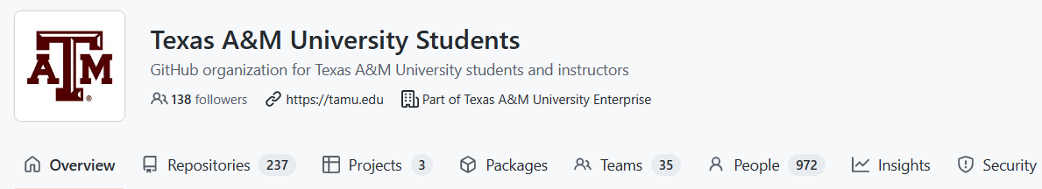
1
Notes:
Press Authenticate to join to join the TAMU GitHub Organization

Slide 14
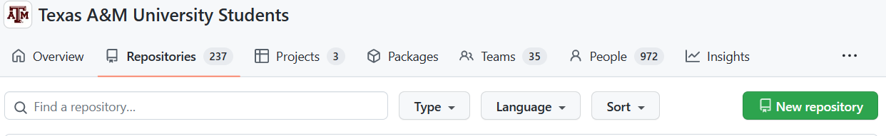
Create a repo for this class
Create a new repository
1
2
Notes:
Click on Repositories and then New Repository to create one.

Slide 15
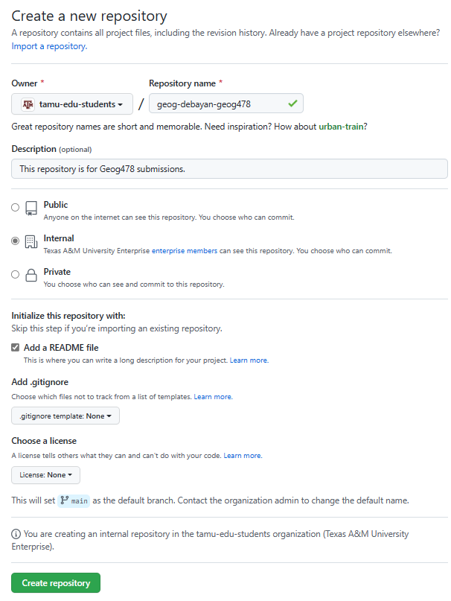
Create a repo for this class
1
2
Put in the name as per suggested convention
<Department>-<YourFirstName>-<CourseID>
Description is usually a good practice to write down
Keep the repository internal
Add a readme file
Markdown file
Don’t add .gitignore file
More on this next slide
3
4
5
Notes:
Please follow the suggested TAMU convention so as not to create issues of name clashes.
Follow steps 1 to 5

Slide 16
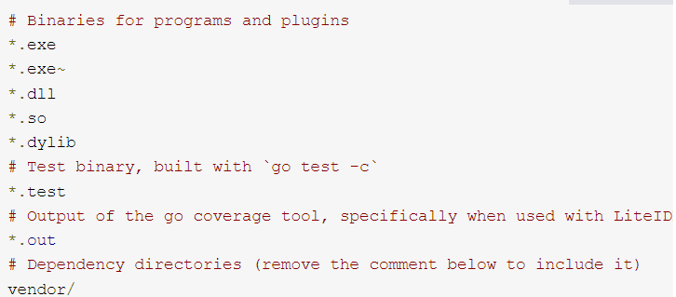
Git Ignore
To ignore sensitive data or system specific files
Notes:
No need to use it. This slide is just for Informational Purposes.
* is used as a wildcard match *.exe will ignore any file with the .exe extension
/ will ignore directories with the name. vendor/ ignores the vendor directory.
# will comment the line, will ignore text on the right of #
[…] will ignore values with any of the values. Example - *.[abc] ignores files file.a, file.b, file.c.

Slide 17
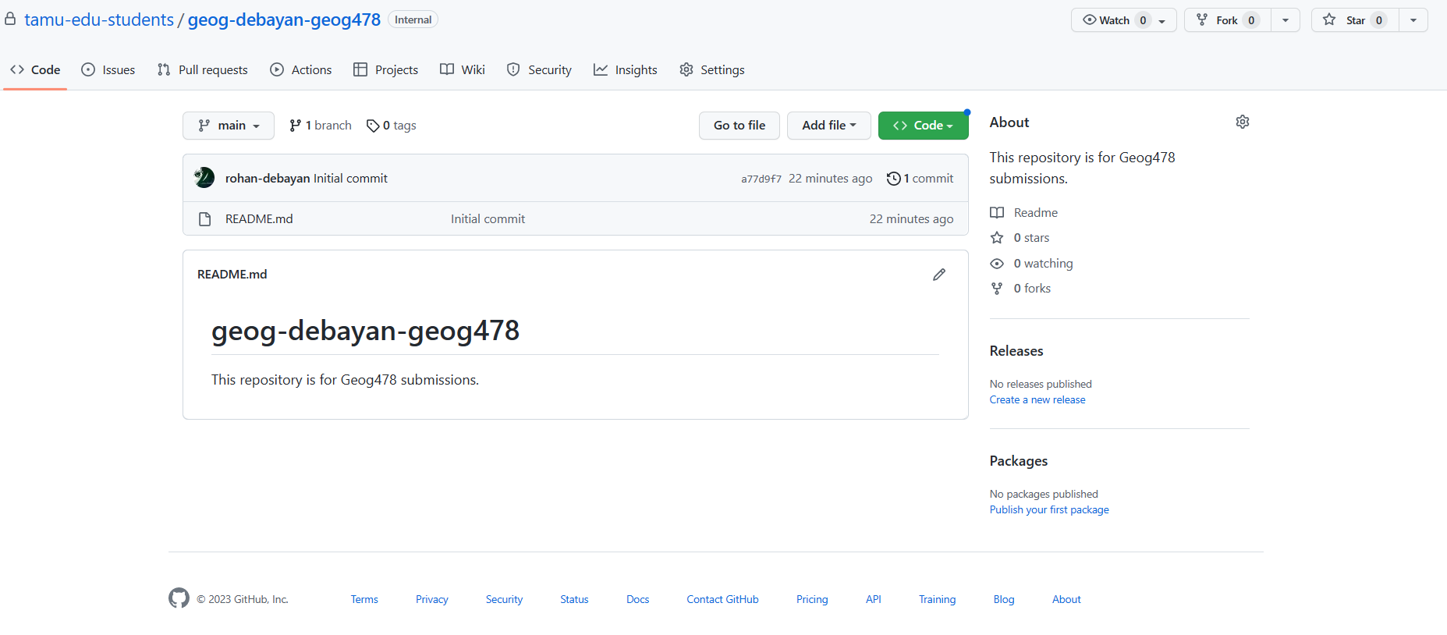
Commits, Files and Commit messages
Notes:
Commits - A commit is a snapshot of your repo at a specific point in time. The highlighted area shows the number of commits.
Files – The highlighted area shows all the files currently present in your online repository
Commit messages – For every change uploaded, it is a recommended practice to note briefly what changes were made in the commit messages. These are mandatory to fill, but can be filled with gibberish text which is highly inadvisable. The highlighted area will show you the inputted text for each commit.

Slide 18
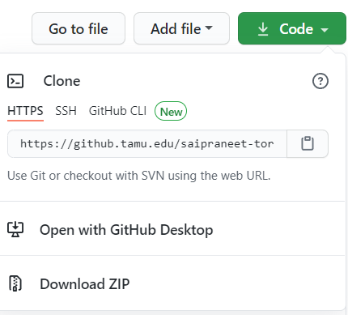
Create Folders and Readme
1
Copy the web URL from HTTPS tab
Unique URL for us to clone the repo
Click on them step by step
Downloading ZIP is another option but not advised
It’s impossible to commit changes using this option
2
3
Not Covered
Not Advised
Notes:
Now, we are going to learn how to create folders and markdown readme using command prompt and Visual Studio. Here only cloning using the web URL will be demonstrated. However, if you are more familiar with another third-party client cloning, feel free to use it. Please don’t use the Download Zip method though.
Click on Code. Follow steps 1 to 2

Slide 19
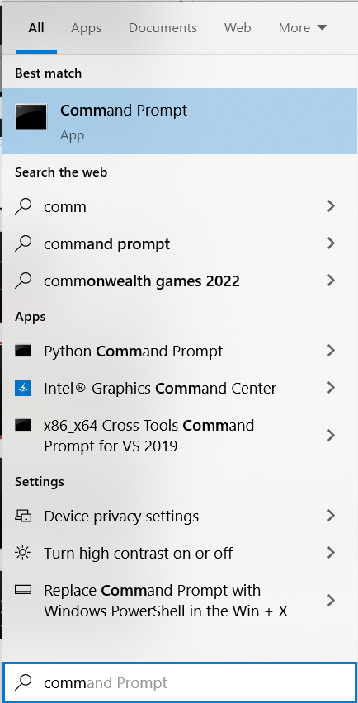

Open Command Prompt
3
Default command line interpreter application available in most Windows operating systems.
Used to automate tasks via scripts, perform advanced administrative functions, and troubleshoot Windows issues.
Follow 1 => 2 => 3 to open it
It will by default open in C:\Users\<yourName>
1
2
Notes:
Follow steps 1 to 3

Slide 20
Checking for git in Windows
git --version (Check in Command Prompt)
If it shows not found, follow instructions in given link
Otherwise skip this slide.
https://support.codebasehq.com/articles/getting-started/git-on-windows
Follow till “Set Up SSH Keys”
Notes:
We need git to push and pull changes from the local computer. So, using the blue text, check for git.
If you are installing it, reopen command prompt and check.
The lab computers will have this installed.

Slide 21
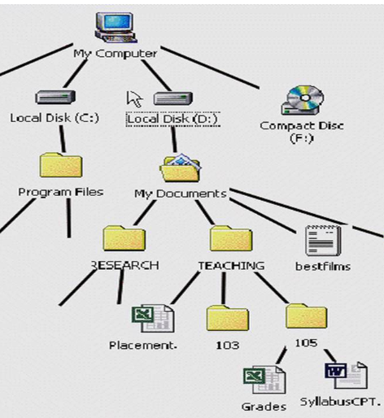
Understanding Paths
ABSOLUTE PATH
D:\My Documents\TEACHING\105\Grades.xls
RELATIVE PATH
105\Grades.xls
You are here!
Come here!
Notes:
Easiest way to understand this is think about everything as door names. Each door leads you to the options available in the bottom. To go there, you need to know the door name.
Absolute Paths will start from the root drive.
Relative path will start from which folder you have currently opened.
These are case sensitive.

Slide 22
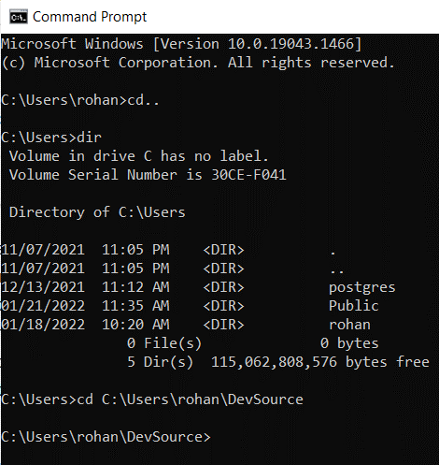
3 basic commands in Command Prompt
dir – Directory
to check the files that exist in that directory
md – Make Directory
Syntax: md <path>
md C:\Users\<name>\DevSource
cd – Change Directory
Syntax: cd <path>
cd.. = This command will go back one folder
cd C:\Users\<name>\DevSource
STEP
1
STEP
2
FINAL RESULT
Notes:
Understanding through equivalent Windows GUI functions.
Directories are equivalent to folders
md is equivalent to right clicking and clicking create new folder
cd is equivalent to moving between folders, opening them by double clicking or pressing back button.
Follow steps 1 to 2

Slide 23
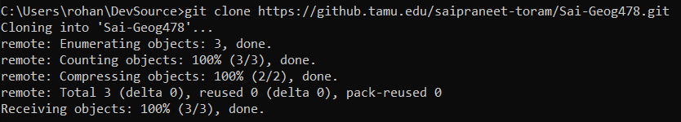
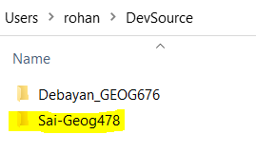
Cloning to Local Computer
git clone – Clone a repository into a new directory
Syntax:
git clone <HTTPSlinkCopied>
Example:
Check it through Windows Explorer
We copied this in step 2 of Slide 21
git clone https://github.tamu.edu/saipraneet-toram/Sai-Geog478.git
Success!
Notes:
Click on git clone to learn more about this command.
It might ask you to login

Slide 24
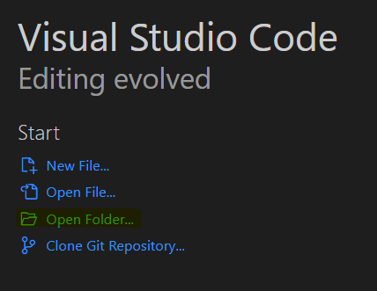
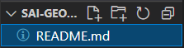
Use Visual Studio Code
Open Visual Studio Code
Open the folder we just created
Open README.md for editing
1
2
Notes:
Visual Studio Code is an integrated development environment (IDE)
We are going to use this in this course extensively. Please feel free to use other interpreters if you are very comfortable with them.
Step 1: Click on Open Folder and navigate to your repository.
Step 2: Open README.md.

Slide 25
Creating Required Folders
Make sure you are within the Repository folder in the command prompt
Create three folders called lab, homework and project in your repository folder
Change current folder to lab
Make folders for all the 8 weeks
1
2
3
Notes:
Follow steps 1 to 3.

Slide 26
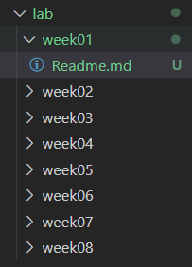
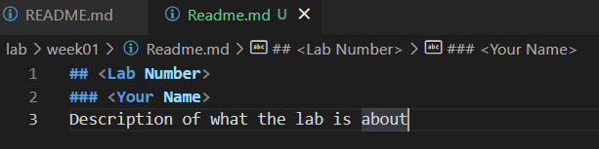
Creating Required Files
1
Create a Readme.md file within the lab/week01 folder in your Visual Studio Code
Fill in the Readme file:
## <Lab Number>
### <Your Name>
<Description of what the lab is about>
2
Notes:
## <Lab Number>
### <Your Name>
<Description of what the lab is about>

Slide 27
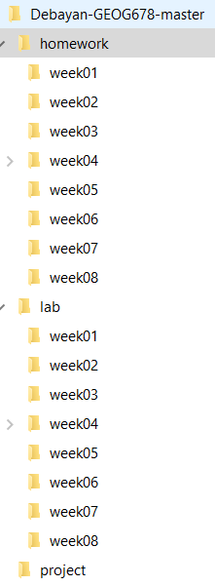
Creating Required Files
Use Windows Explorer:
Copy the Readme.md to all the weeks of the lab folder.
Don’t change other readmes now. These can be updated when the other labs are done.
Copy the whole content to the homework folder.
Leave project folder empty.

Slide 28
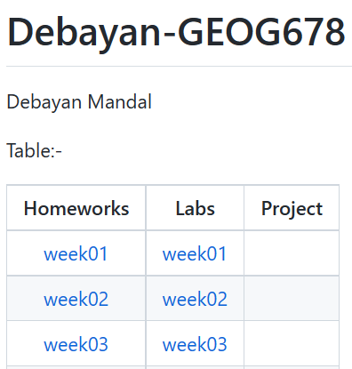
Making the content Readme file
As for our main content Readme file, we want to create a table of contents.
It will have links to go to the respective folder when clicked
We are going to use Markdown
Notes:
Markdown is not meant to replace Markup, such as, Instead, it is just a very small subset of HTML tags to make users easy to read, write and edit web pages. By addressing this, Markdown is specified to be able to do block elements, such as paragraphs and line breaks, code blocks and span elements, such as links and images.

Slide 29
Making the table
Syntax
Format
The dashes denote span of column
Column Text Alignment
Left Alignment –
Default without colons
Center Alignment –
Both sides colon
Right Alignment –
Colon on the right side
|| is one column
Table:-
| Homeworks | Labs | Project |
| :-------------: |:-------------:| :-----:|
| [week01](homework/week01) | [week01](lab/week01) | |
| [week02](homework/week02) | [week02](lab/week02) | |
| [week03](homework/week03) | [week03](lab/week03) | |
| [week04](homework/week04) | [week04](lab/week04) | |
| [week05](homework/week05) | [week05](lab/week05) | |
| [week06](homework/week06) | [week06](lab/week06) | |
| [week07](homework/week07) | [week07](lab/week07) | |
| [week08](homework/week08) | [week08](lab/week08) | |
Cell Headings
Link Address of the Folder (Relative Path)
Link Text that would be visible
Blank Cell
Notes:
For table alignment, default without colons in the second line is left, both sides colon is center and right-side colon is right aligned.
The dashes denote span of the column.

Slide 30
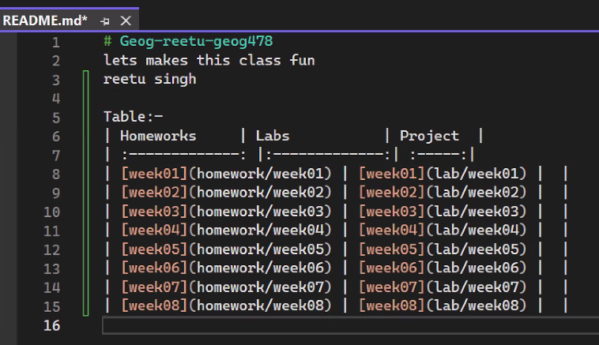
Editing the Readme file
The README.md file should look like this at the end of this step
Notes:
Table:-
| Homeworks | Labs | Project |
| :-------------: |:-------------:| :-----:|
| [week01](homework/week01) | [week01](lab/week01) | |
| [week02](homework/week02) | [week02](lab/week02) | |
| [week03](homework/week03) | [week03](lab/week03) | |
| [week04](homework/week04) | [week04](lab/week04) | |
| [week05](homework/week05) | [week05](lab/week05) | |
| [week06](homework/week06) | [week06](lab/week06) | |
| [week07](homework/week07) | [week07](lab/week07) | |
| [week08](homework/week08) | [week08](lab/week08) | |

Slide 31
Committing the files to Repository
Within the repository in command prompt:
git config --global user.name <yourName>
git config --global user.email <GitHub email>
git config --global credential.username <yourUsername>
1
2
3
Notes:
Use --global after git config for global

Slide 32
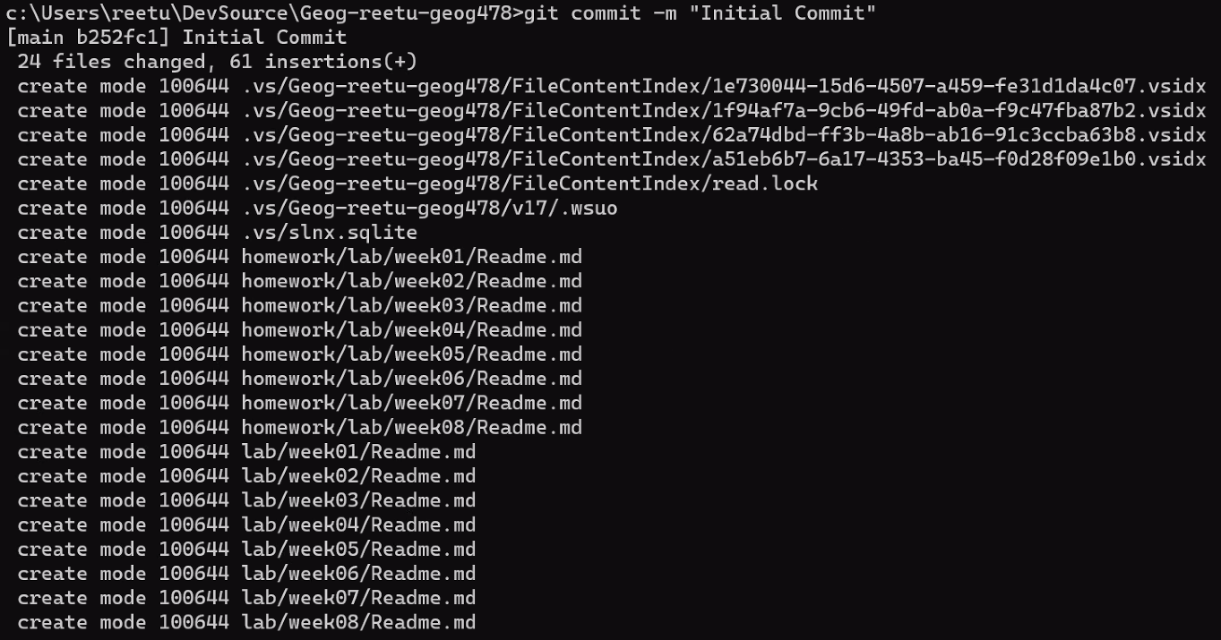
Committing the files to Repository
Staging the changes:
git add *
git commit -m “Initial Commit”
Notes:
Follow step 1 to 2

Slide 33
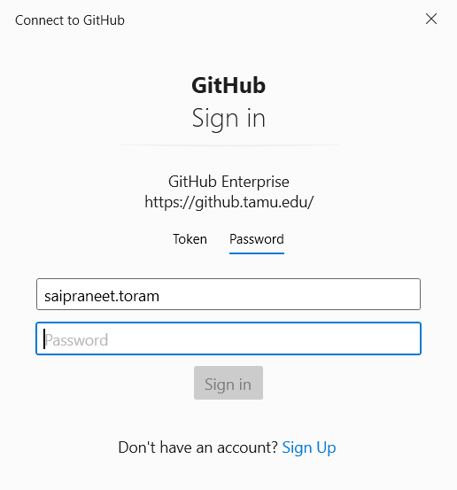
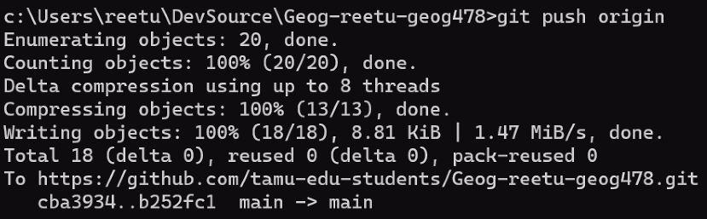
Committing the files to Repository
Uploading the changes:
git push origin
If the password is asked in the command prompt, the input will not be shown. Please enter the full password and press enter.
Notes:
Potential Pitfall: The git commit may require authentication!

Slide 34
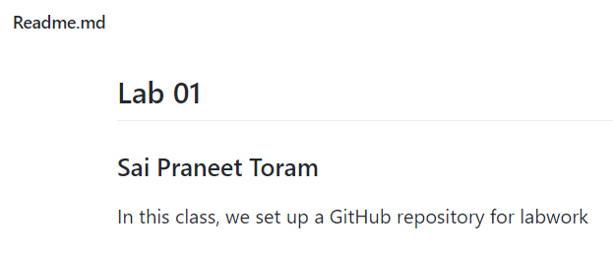
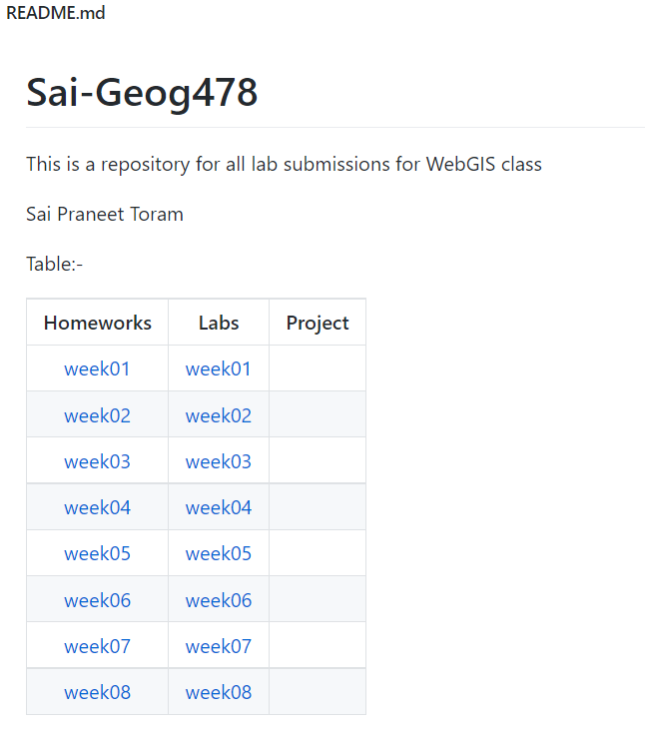
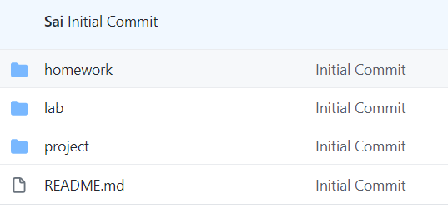
Final Look

Slide 35
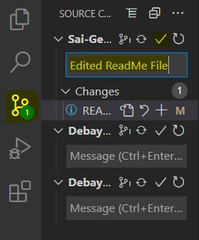
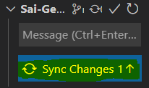
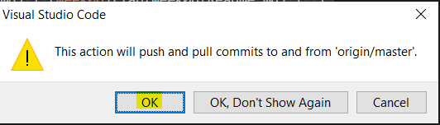
Committing using VS Code
Notes:
Extra Information: Will be taught in another lab class!

Slide 36
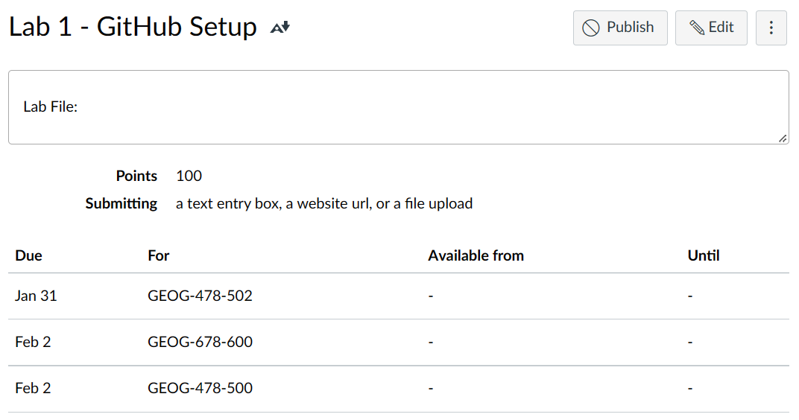
To Hand In
Submit your GitHub URL into the online Lab assignment link
Due Date: On the class day of Next Lab

Slide 37
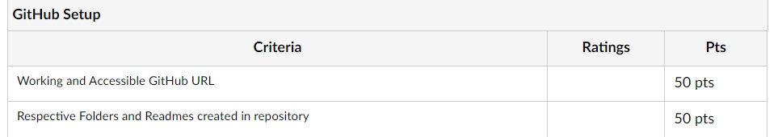
Rubrics:

Slide 38
Thank You
Any Questions?

